Slide 1
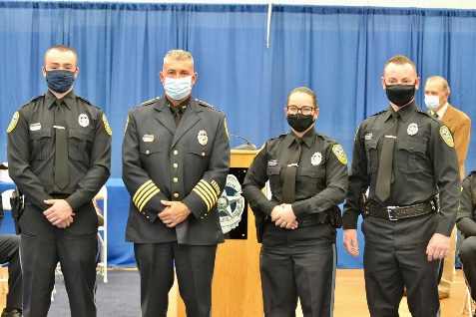
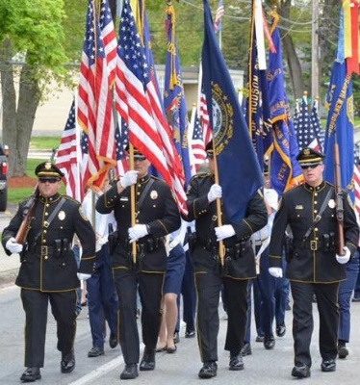
Hudson Police Officer Testing
Date: Thursday, September 15, 2022
Time: 5:30 PM
Location: Alvirne High School
200 Derry Street
Hudson, NH 03051
-Applications are available at
www.PoliceApp.com/HudsonNH
- Non-Certified Application deadline is Friday, September 9, 2022.
- Non Certified starting salary $58,904.56
- Certified officers starting range between $61,744.64- $72,953.20
- No application deadline for certified officers
- For more information, contact Master Patrol Officer Ronald Cloutier at (603)816-2272 or email: rcloutier@hudsonnh.gov.
The Hudson Police Department is an Equal Opportunity Employer.
All are encouraged to apply.

